Slide 1
Afraid of Missing the Rally?
[Advisor Name]

Slide 2
Some good news.
Curve is flattening
Some states opening businesses back up, others will soon
Summer months expected to reduce infection rate
Substantial bi-partisan economic stimulus implemented

Slide 3
“We have not done anything because we haven’t seen anything that attractive.”
⁠— Warren Buffett, May 2, 2020
Notes:
Berkshire Hathaway had their annual shareholders meeting on Saturday, May 2. When asked why they haven’t made any significant investments during the recent market selloff, despite holding a record $135b in cash, Warren Buffet simply replied, “We have not done anything because we haven’t’ seen anything that attractive”. Berkshire sold over $10b worth of equities during Q1. Despite short-term fluctuations, Warren Buffett’s long-term track record is why this meeting is such a big annual event for investors. Berkshire Hathaway A shares have returned nearly 21% annually since 1976, more than double the return of the S&P 500′s 10% return over the same time, according to FactSet. Over the last year, Berkshire has lost 15%, compared to the S&P 500′s 1% loss. Berkshire’s heavy investments in banking and insurance has hurt it during this dramatic economic slowdown.

Slide 4
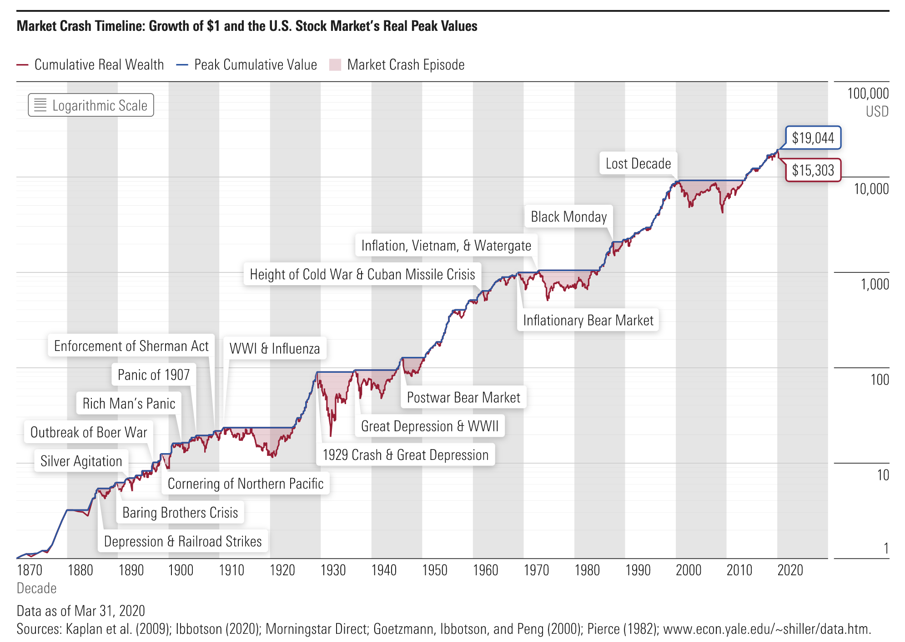

Slide 5
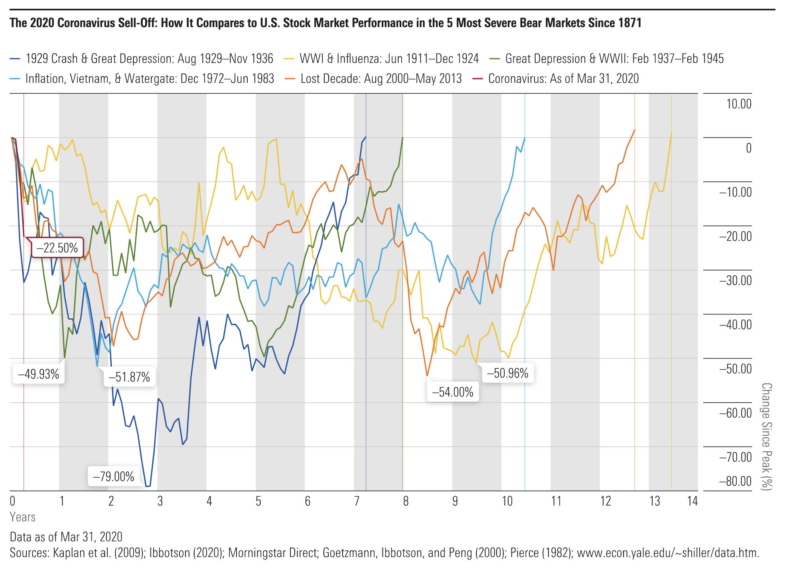

Slide 6
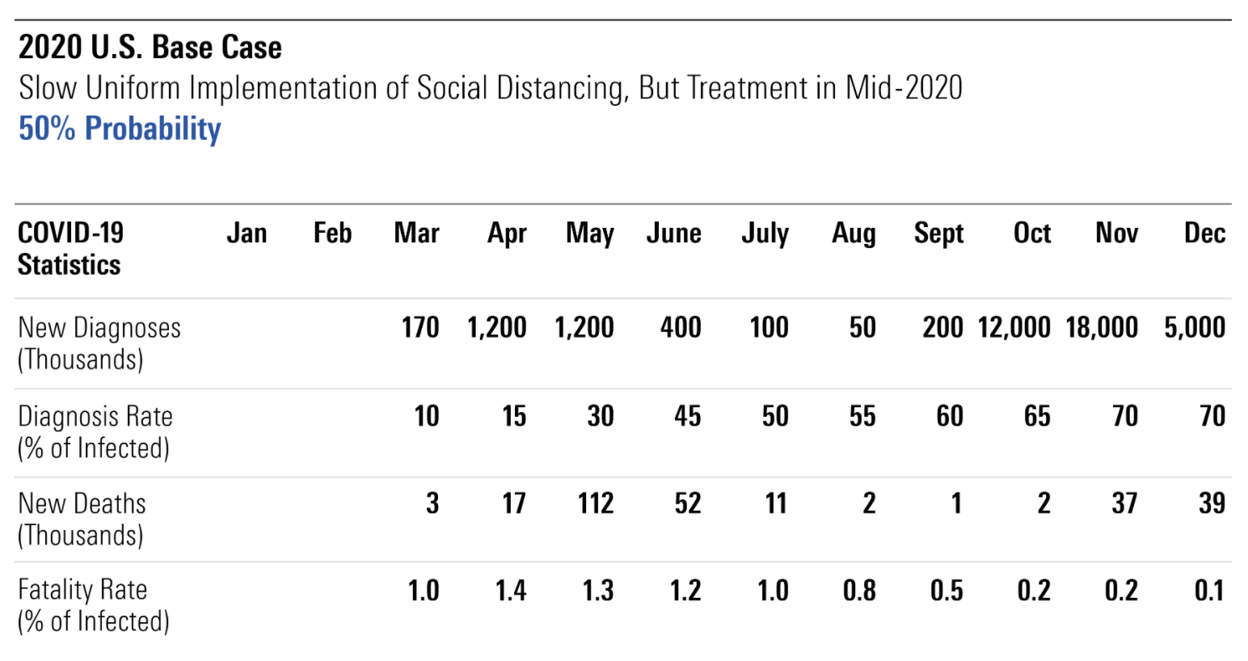

Slide 7
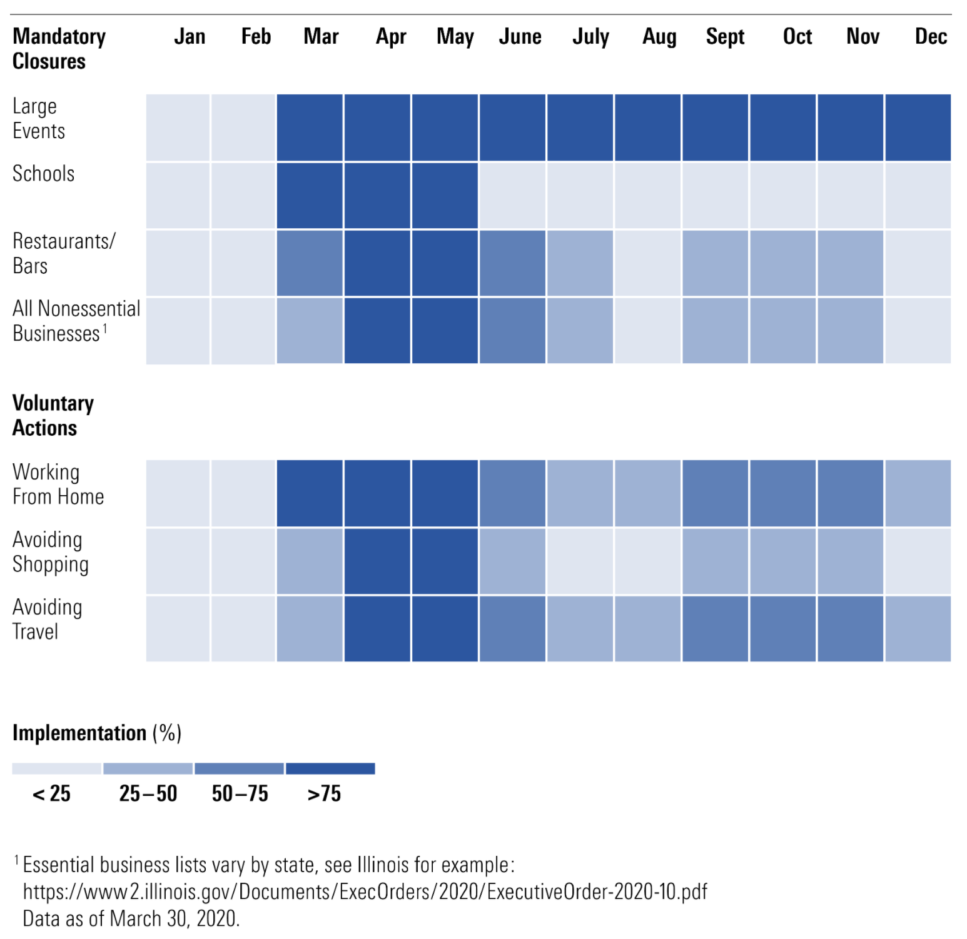

Slide 8
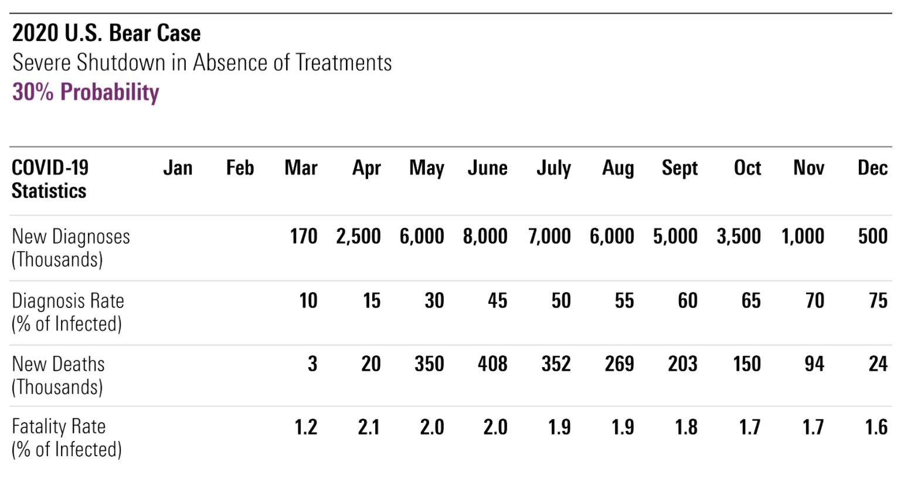

Slide 9
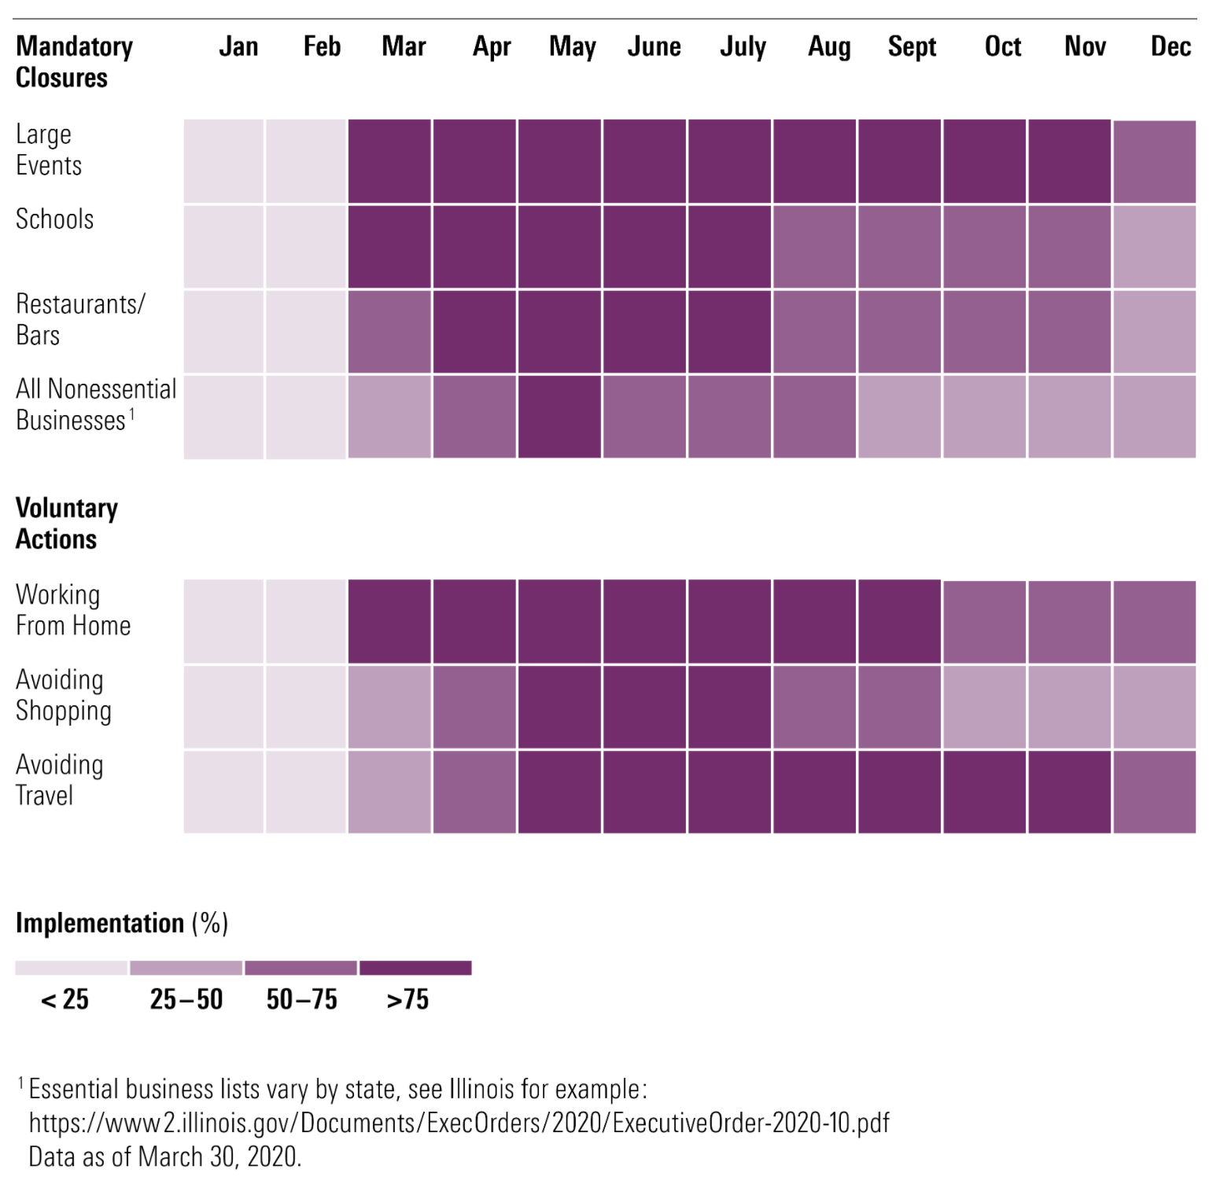

Slide 10
What happens next?
Historic rise in unemployment
Historic closure of small business
Most interest rate sensitive investments will suffer
Human behavior will change
Source: https://www.cnbc.com/2020/04/14/7point5-million-small-businesses-are-at-risk-of-closing-report-finds.html
Notes:
These figures point to 3.5 million small businesses closing permanently in the next two months, and 7.5 million over the next five months, according to Main Street America.

Slide 11
“Perhaps with a bias, I don’t believe anyone knows what the market is going to do tomorrow, next week, next month, next year. I know America’s going to move forward over time, but I don’t know for sure and we learned this on Sept. 10, 2001. And we learned it a few months ago in terms of the virus. Anything can happen in terms of markets. And you can bet on America but you’re going to have to be careful about how you bet. Simply because markets can do anything.”
⁠— Warren Buffett

Slide 12
What to do now.
Don’t make emotional decisions
Try to stop clients from making emotional decisions
It’s okay to be balanced, or even conservative
Be ready for this to materially change your business

Slide 13
Ways we can help.
Update financial plans for concerned clients
Provide timely market and portfolio updates
Help with online marketing
Facilitate sharing of best practices

Slide 14
Disclosure
[Insert disclosure text from your compliance team here, this template is intended for financial professionals only.]

